Slide 2
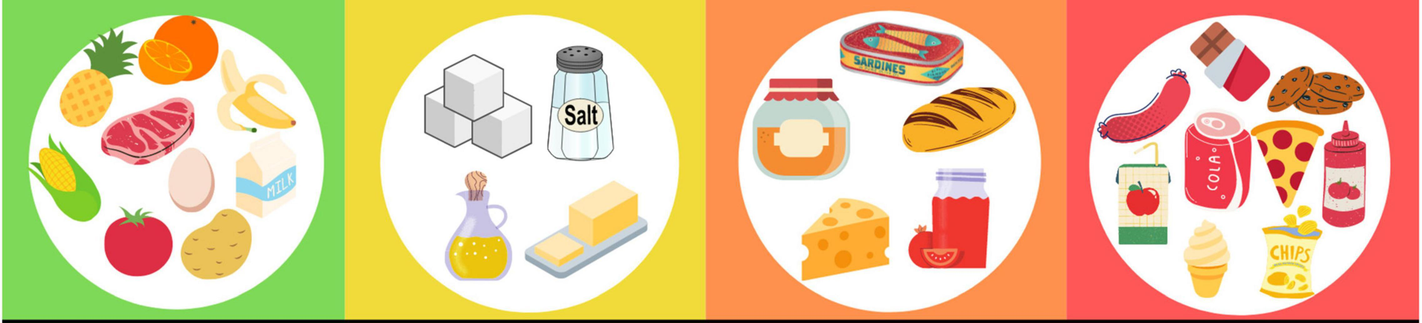
Food Insecurity Understudied Potential Risk Factor for HDP
Food Insecurity (FI) associated with notable alterations in food quantity and/or quality ⁴
Individual level factors (income, disability) + multilevel elements of food insecurity (neighborhood food stores access, environment etc. )
FI is a social determinant of health we can use for predicting adverse health outcomes including including obesity, hypertension^{4,5}
Vulnerable Groups:
Single unmarried women most likely to be impacted^{3,4}
Racial/ethnic, low income individuals^{3,4}
Food Insecurity
Notes:
ALONG WITH THESE RISK FACTORS OF EMERGING CONCERN FOR RELATION TO SEVERAL OF THOSE RISK FACTORS and DISPARITIES AND POTENTIALLY DIRECTLY WITH HDP is FI
Multifaceted issue (several levels of drivers)
Food insecure individuals alternate between a state of hunger and consumption of low-cost, high calorie nutrient intake to avoid hunger
Shown in green figure---shown in red figure
Paritally due to income at individual level but certainly exacerbated by multievel components of food insecurity that consider community level barriers (food stores
Also potential other mechanism of times of abundance food insecure individuals may overeat, resulting in chronic fluctuations between low calorie intake and overeating (also impacting metabolic changes that impact fat storage)
ADDITIONAL: overweight/obesity higher amongst women who are FI then men. Possible mechansim is through children and reduction of their own nutritional intake.
During pregnancy, may be especially detrimental
Food Insecurity, affects approximately 11% of US housholds as of 2018 is defined by the USDA as lack of consistent access to enough food for an active healthy lifestyle.
Further conceptualized food insecurity as range varying severities altering food quantity and food quality impacted by:
Show disparities of FI

Slide 3
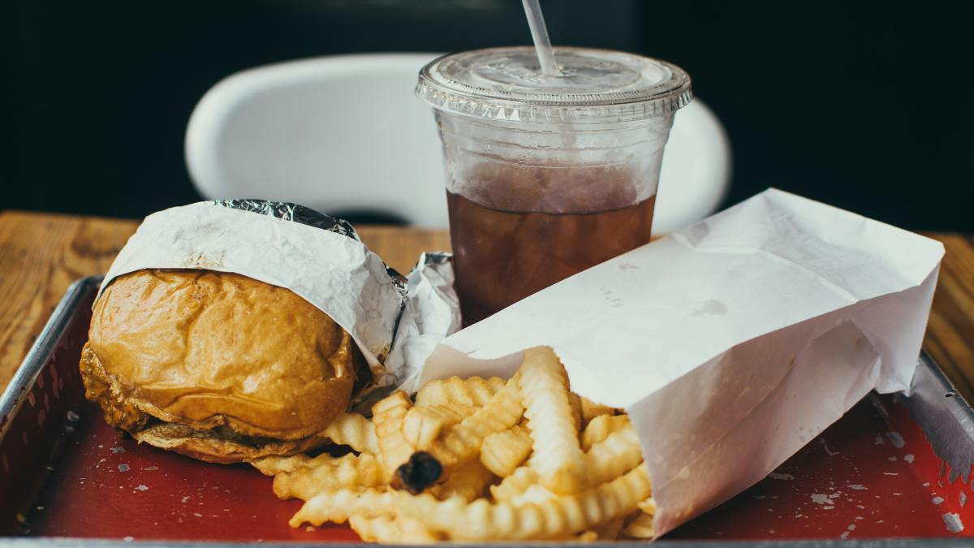

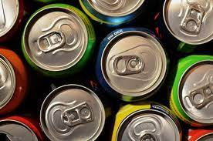
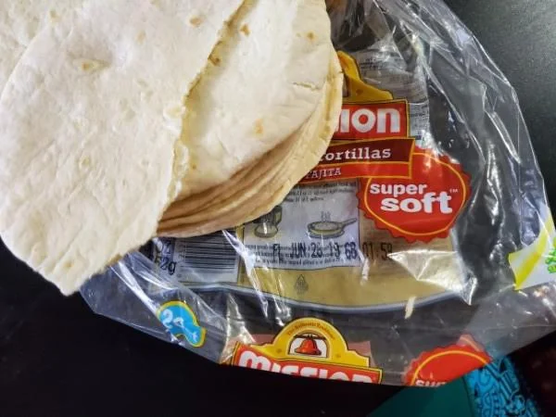
Food Insecurity and Increased Risk of Environmental Chemical Exposure
Phthalates
Phenols
FI Individuals
Packaged Food Wrappers
Fast Food Wrappers
Exposure
Soda Pop Cans
Preservatives
Canned Foods
Notes:
Phthalates used as plasticizers and phenols used as coatings and preservatives
Exposure conditions leach into food sources (not covalently bound!)
Route of exposure for food based sources
Readily metabolized and excreted
FI again however may result in increased exposure, and persistence in food enviornment (especially considering impact from neighborhood level barriers)-- creating chronic expousre conditions.
The conditions of exposure influence the nature of small molecule migration, such as the nature of the food (fat, oil, acidic, aqueous), storage condition (temperature and time), and processing condition (temperature of in packaging cooking/heating)
Thus, there can be substantial variability in phthalate concentrations within food groups based on the region of food production, processing practices, presence and type of packaging and lipid content

